Slide 1
Implementing Language Access Plans: What Works? What Counts?
Evaluation Results
Azadeh Khalili
October 5, 2011

Slide 2
Table of Contents
Evaluation Overview
Quick Snapshot of Participant Ratings
Results from the Morning Session
Results from the Afternoon Breakout Sessions
Considerations and Implications for Next Steps

Slide 3
Evaluation Overview
AECF evaluation forms measured extent to which convening achieved 5 desired results:
    Understand how language access contributes to achieving agency’s mission
    Identify strategies and action steps to move language access forward
    Connect with colleagues from other agencies to learn and share ideas
    Use knowledge, skills, and networks gained today to strengthen my language access work
    Know who to contact for TA going forward
Also asked:
    Effectiveness of morning speakers and roundtable discussions
    What participants found useful
    What would have been more useful
    Other comments
Separate evaluations of morning session (116 respondents) and afternoon breakouts (77 respondents)

Slide 4
Snapshot of Participant Ratings:
The Convening Was Productive Use of Time

Slide 5
Results from the Morning Session

Slide 6
Results of Morning Session

Slide 7
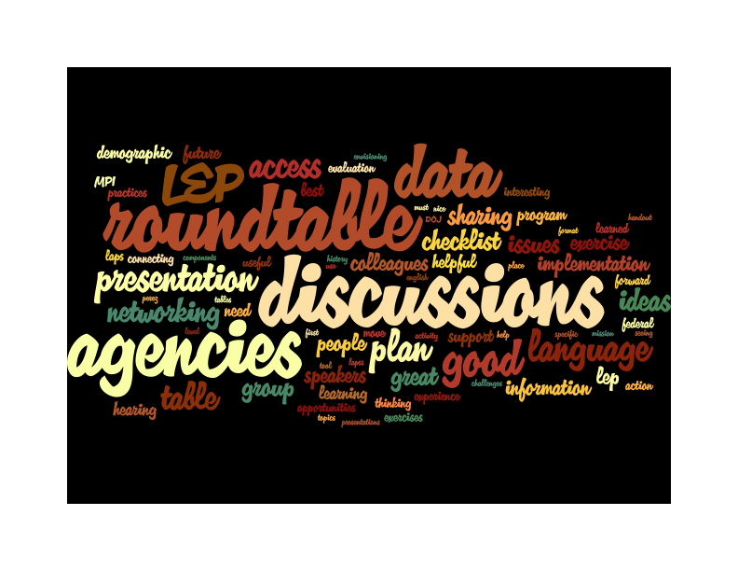
What was most useful about the morning?
Note: Relative size of words reflects how often they were mentioned in participant responses.

Slide 8

What would have made the morning more useful?
Note: Relative size of words reflects how often they were mentioned in participant responses.

Slide 9
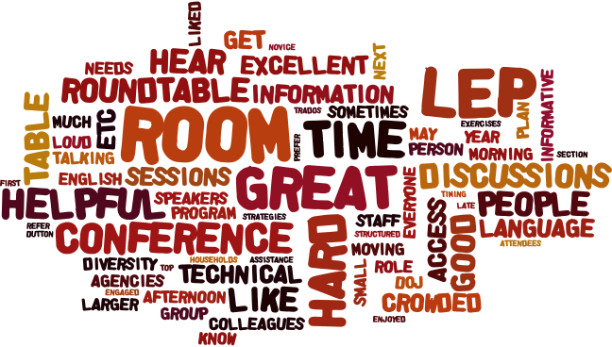
Additional comments from the morning session…
Note: Relative size of words reflects how often they were mentioned in participant responses.

Slide 10
Results from Afternoon Breakout Sessions

Slide 11
Aggregate Results of Afternoon Breakout Sessions
Session A (n=76)
Session B (n=64)

Slide 12
Results of Each Breakout Session
* Results are the aggregate responses for the 3 desired results: learned new skills; helped refine action plan; and connected with colleagues.

Slide 13
Results of Concurrent Breakout #1:
Meeting Your Agency’s Translation Needs
Session A (n=20)
Session B (n=3)

Slide 14
Results of Concurrent Breakout #2:
Interpretation Testing and Training
Session A (n=16)
Session B (n=18)

Slide 15
Results of Concurrent Breakout #3:
Interpretation Using Outside Vendors
Session A (n=10)
Session B (n=9)

Slide 16
Results of Concurrent Breakout #4:
Best Practices in Contracting
Session A (n=10)
Session B (n=10)

Slide 17
Results of Concurrent Breakout #5:
Monitoring and Evaluation
Session A (n=19)
Session B (n=24)

Slide 18
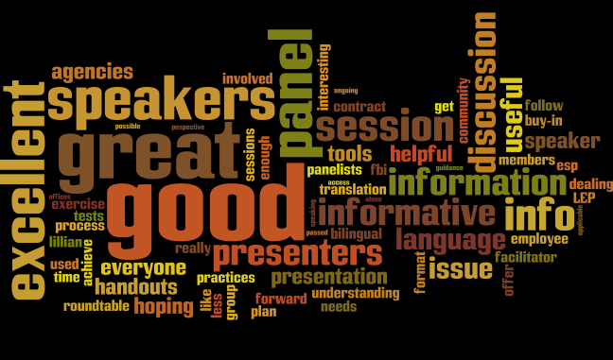
Comments from afternoon breakout sessions
Note: Relative size of words reflects how often they were mentioned in participant responses.

Slide 19
Considerations and Implications for Next Steps
Design team set very ambitious goals for a single day with a large, heterogeneous group
High demand among participants for continued engagement:
  Examples of DOJ-approved LAPs
  Peer learning from federal agencies linked to specific elements/challenges of their own LAPs
  More intentional networking (eg, all law-enforcement, mix-max from multiple agencies) with more choice of content
  Responsive to concerns re: logistics (eg, room, handouts, etc)
Opportunities to leverage greater role for federal LA task force members

