Slide 1
Illegal immigration in the US
Gordon Hanson
UC San Diego & National Bureau of Economic Research

Slide 2
Consensus on immigration?
“We need immigration reform that will secure our borders and bring the 12 million people here illegally out of the shadows. We must assert our values, as a nation of immigrants and a nation of laws.”
Barack Obama, June 28, 2008
“America’s immigration system is outdated, unsuited to the needs of our economy and to the values of our country. We should not be content with laws that punish hardworking people…”
George W. Bush, February 2, 2005

Slide 3
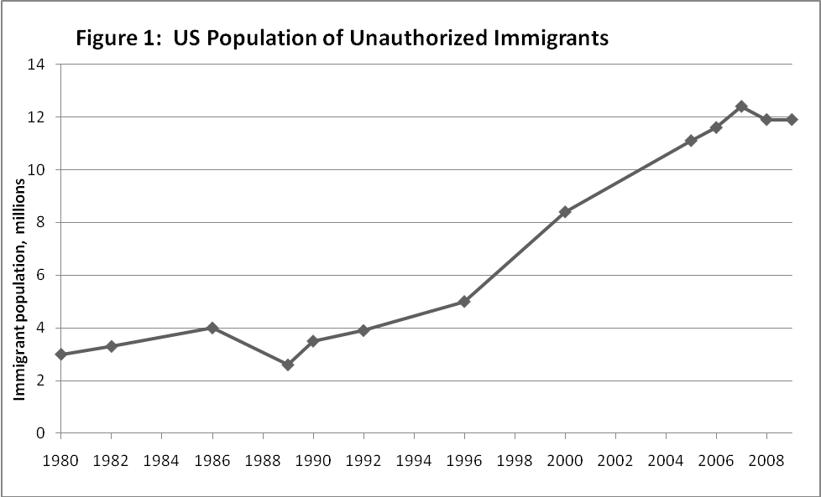
1. Illegal immigrants are a large part of the unskilled US labor force

Slide 4
2. Illegal immigration responds to market conditions in ways that legal immigration presently cannot

Slide 5
3. The overall impact of illegal immigration on the US economy appears to be small
Short-run net income gain is ~0.03% of US GDP
  “Immigration surplus” (productivity gain to business)
Short-run net fiscal cost is ~0.10% of US GDP
  Public services used by immigrants less taxes paid
Net impact is -0.07% of GDP (close to a wash)

Slide 6
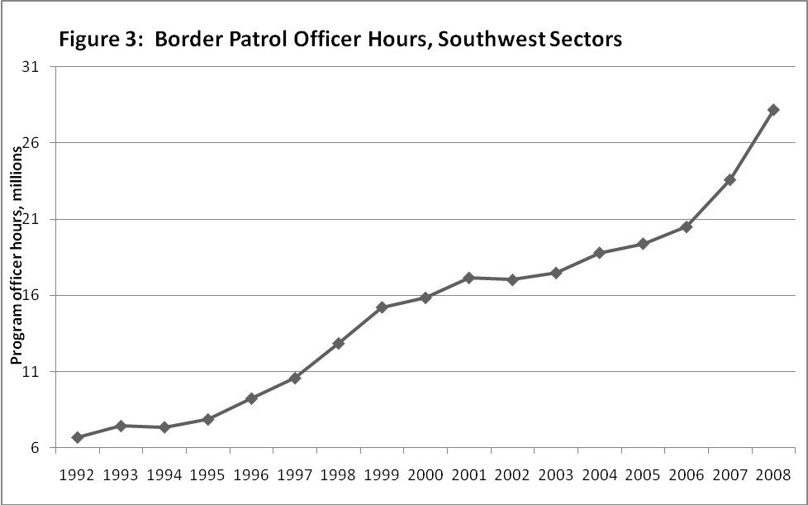
4. Enforcement against illegal immigration is costly (relative to gains from eliminating illegal entry)
US enforcement budget: $15bn (20,000 BP agents)

Slide 7
A guide for immigration reform
Enforcement only would be expensive
  And may cost more in terms of extra resources than it would yield in fiscal savings to the US economy
Legal low skilled immigration could pay for itself
  The US could offset the fiscal expense of low skilled immigration by increasing entry fees (with legal flows)
Flexible visa supplies would enhance efficiency
  Low skilled immigration helps US employers more when it is allowed to fluctuate with the business cycle

